Slide 1
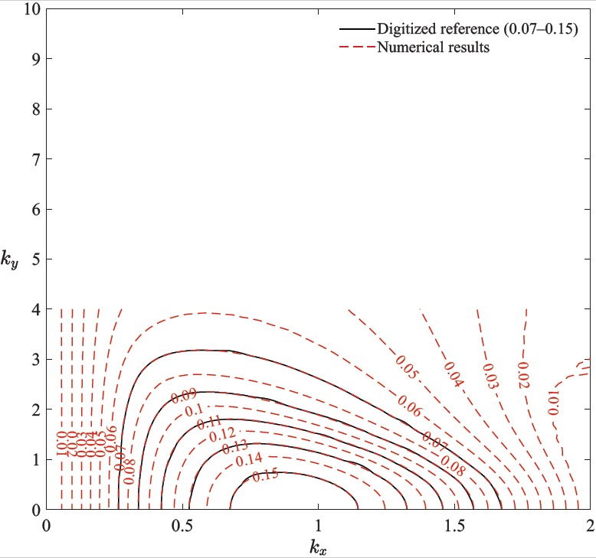
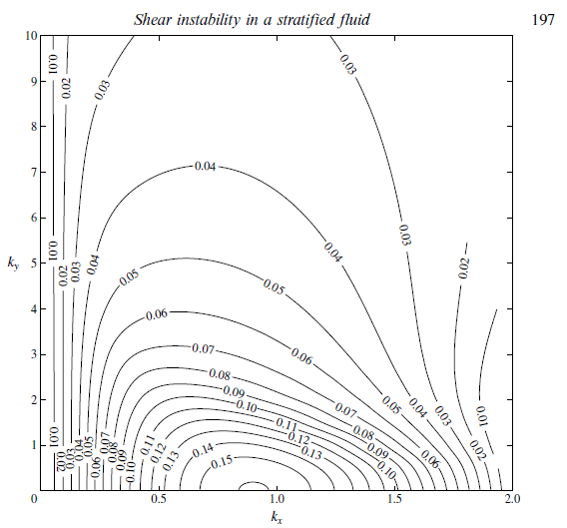
Candelier J, Le Dizès S, Millet C. Shear instability in a stratified fluid when shear and stratification are not aligned. Journal of fluid mechanics. 2011 Oct;685:191-201.

Slide 2
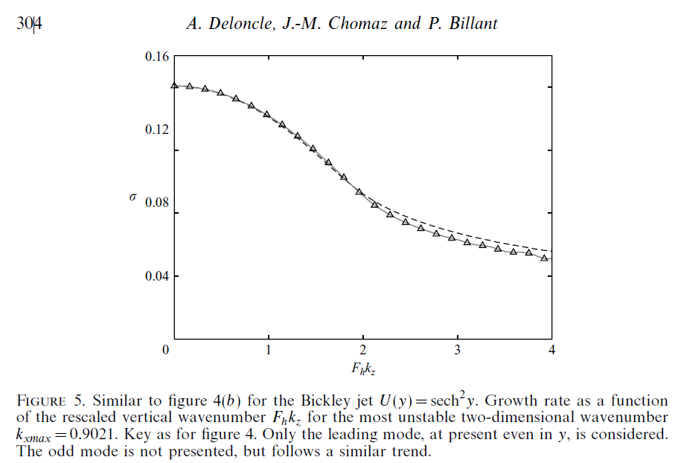
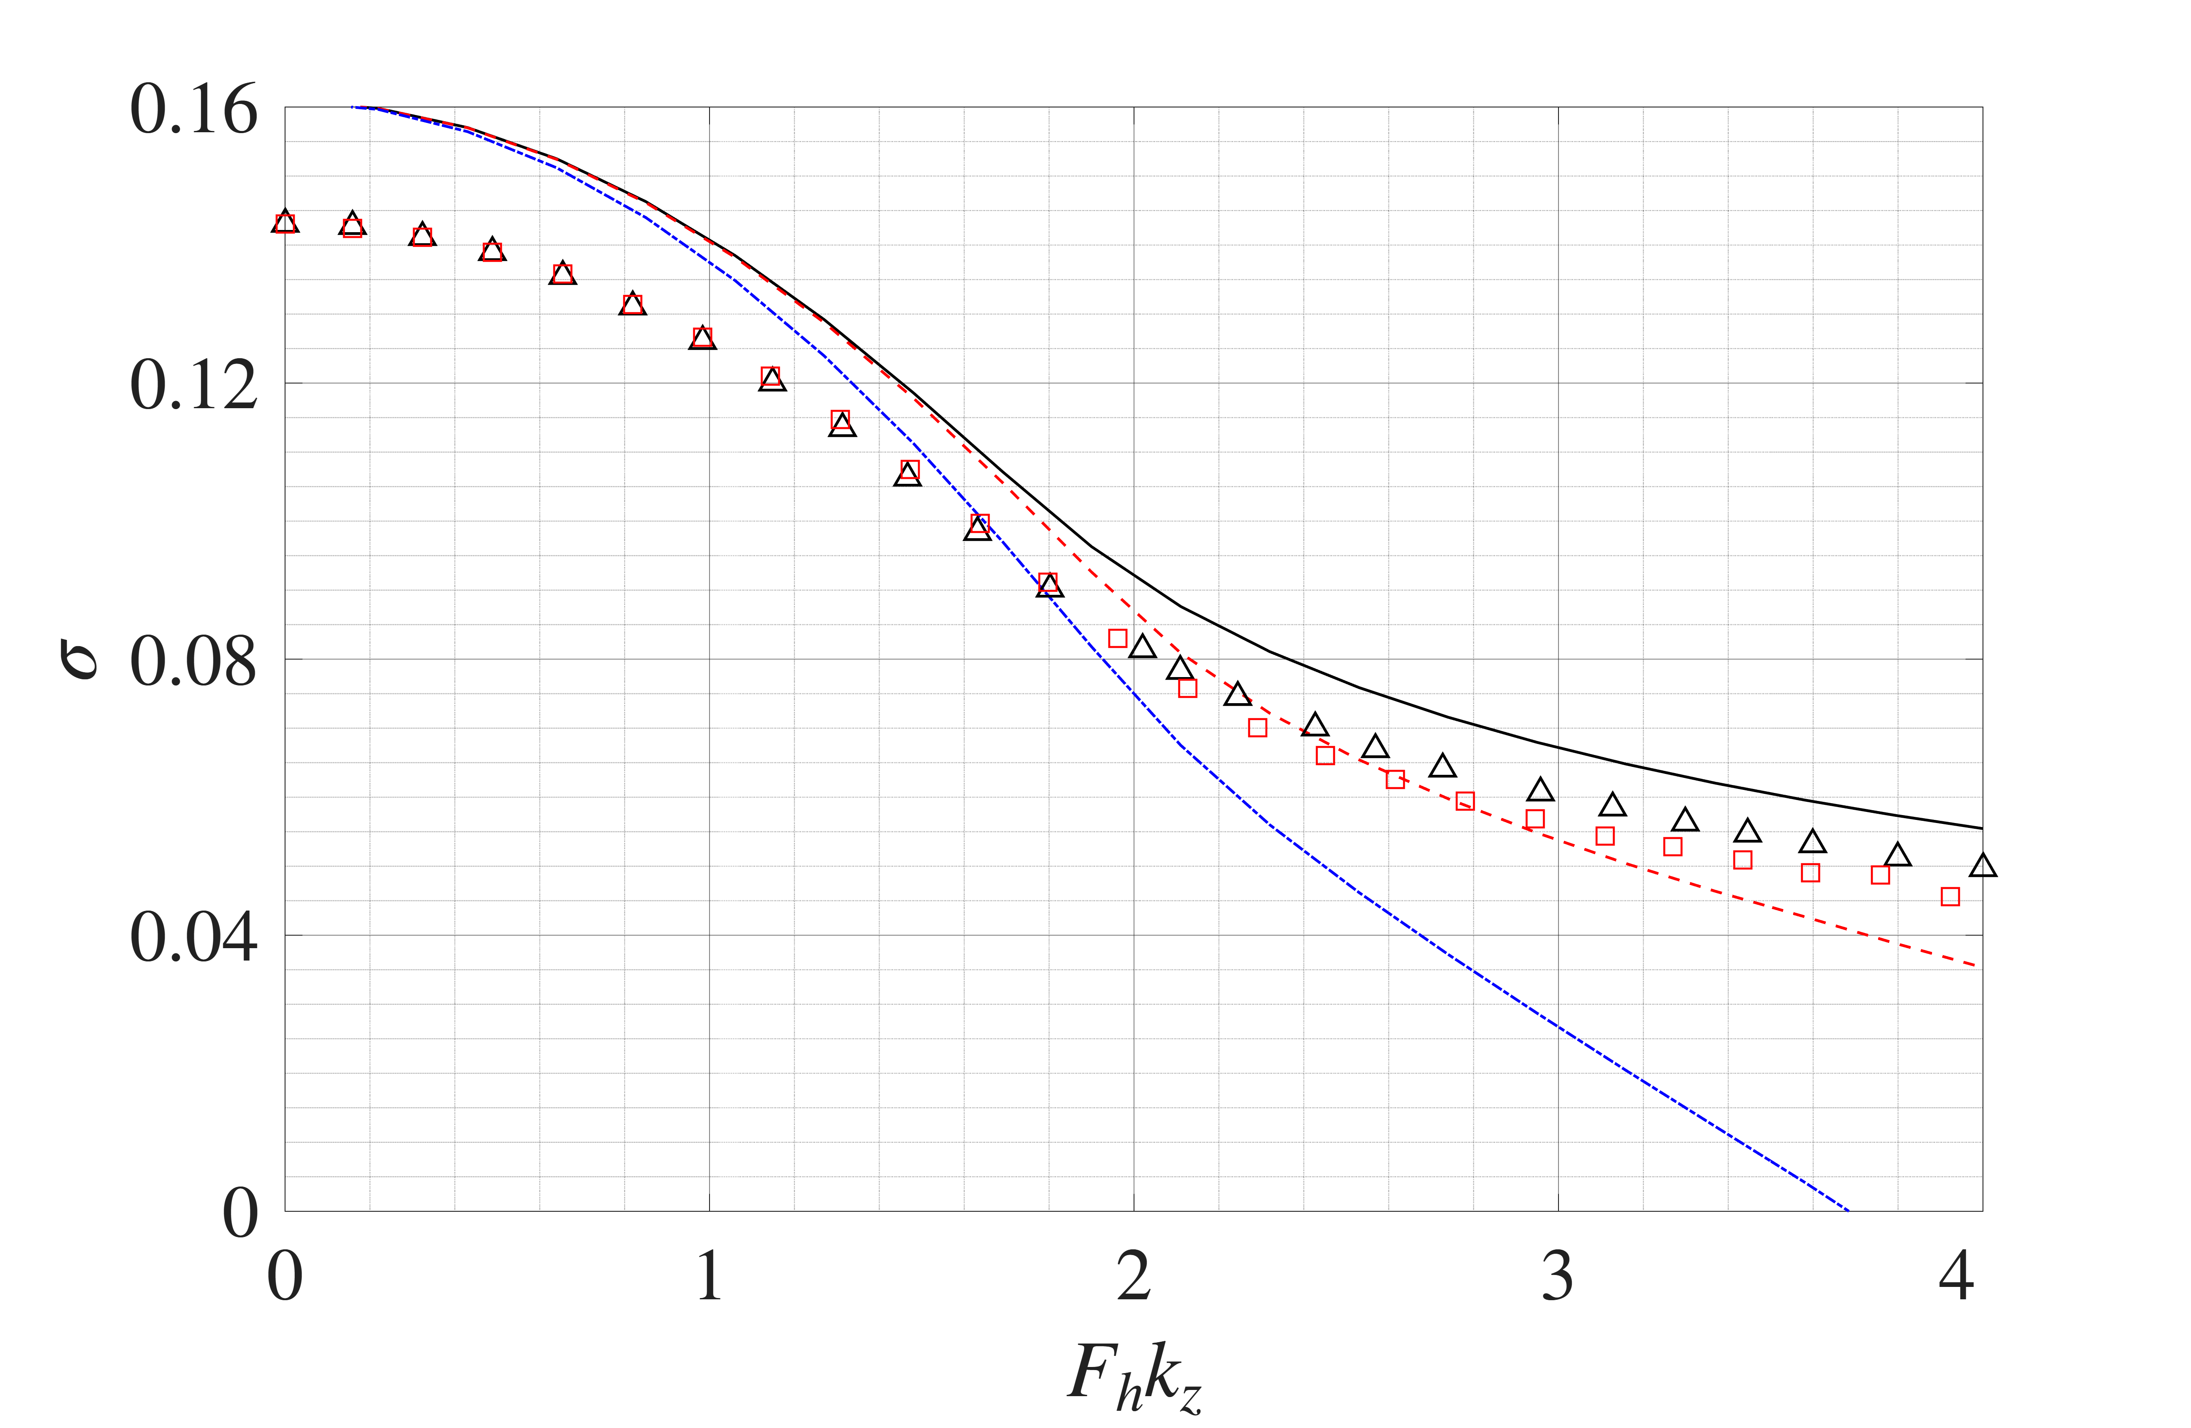
Deloncle A, Chomaz JM, Billant P. Three-dimensional stability of a horizontally sheared flow in a stably stratified fluid. Journal of Fluid Mechanics. 2007 Jan;570:297-305.

Slide 3
